Slide 1
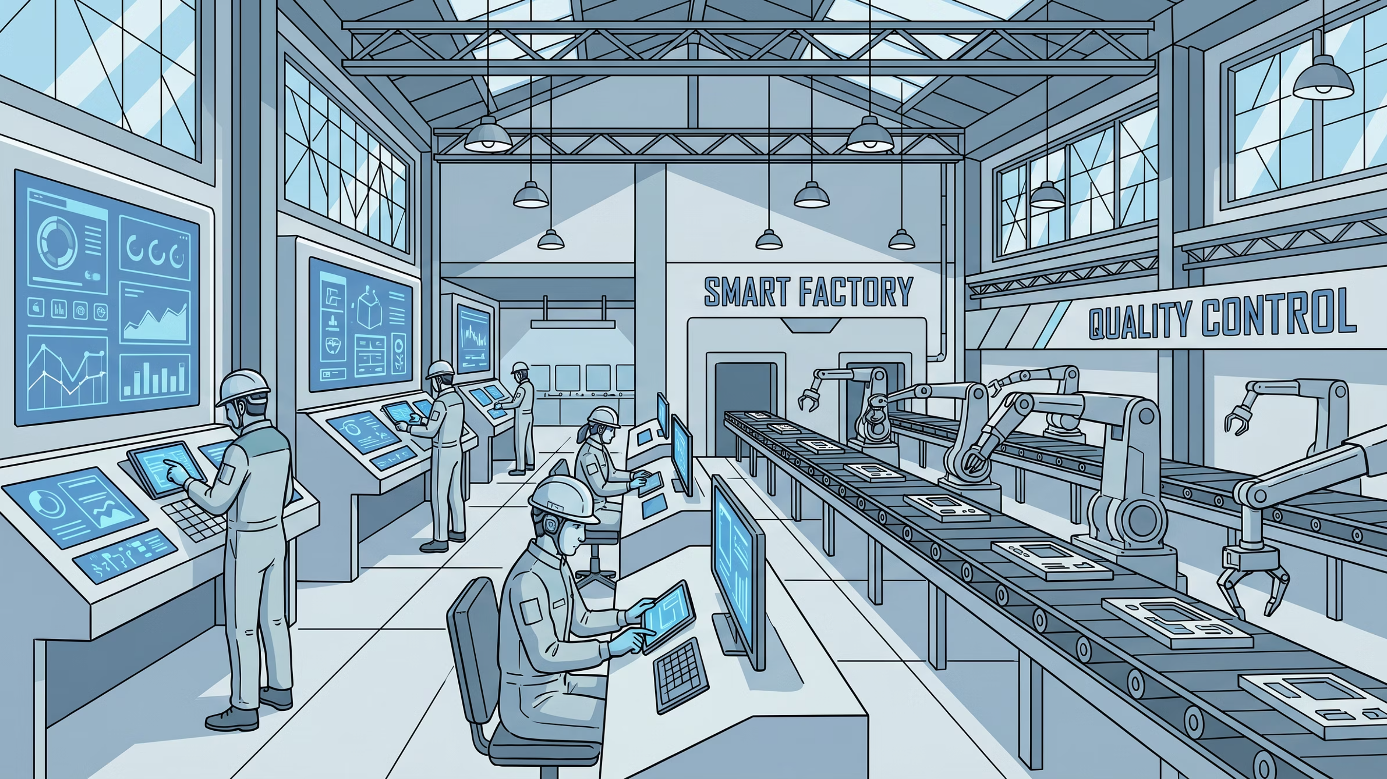


Data Safety for Manufacturing Teams
A 20-minute walkthrough for every employee with access to customer data, designs, or financials.
20-minute walkthrough. Print, hand to your team, run it monthly with new joiners.

Slide 2
WHY THIS MATTERS
The cost of one small mistake.
₹4.3Cr
A 40-employee Mumbai SMB. One employee. One forwarded file. One personal Gmail account.
90 days
Time taken to discover the breach.
Zero ransomware
No malware. No external hacker. Just one forwarded email.
The cost of one customer master file forwarded to a personal Gmail.
100% preventable
A single rule, followed, would have stopped it entirely.

Slide 3
THE 3 RULES
Three rules. Every employee. Every day.
1
2
3
Customer data stays in company systems
Designs leave only with management approval
Personal devices are not for company files
No forwarding, no personal storage, no workarounds.
CAD files, drawings, BOMs — all require explicit sign-off.
Your personal phone, laptop, or tablet is not a work device.

Slide 4


RULE ONE
Customer data stays in company systems.
Knowing where your company systems end — and where they do not — is the first line of defence.
Company systems — approved
Not company systems — never use
Tally and ERP platforms
Personal Gmail or any personal email account
Microsoft 365 or Google Workspace (company account)
WhatsApp Web on a personal phone
Sanctioned shared drives and file servers
USB drives not issued by the company
Personal cloud backups (Google Drive personal, iCloud, Dropbox)

Slide 5


RULE TWO
Designs leave only with management approval.
What this covers
The screenshot loopholeEven if you cannot export a file directly, a screenshot of a CAD screen is still a design leaving the building. The same rule applies.
CAD files, engineering drawings, BOMs, product specifications, and any document that describes how something is built, dimensioned, or assembled requires explicit written approval from management before it leaves company systems.
A case study that happens every week
The action
When in doubtIf you are not certain whether sharing a file requires approval — assume it does. Ask your manager. It takes two minutes and protects everyone.
A designer screenshots the new product CAD file and sends it to personal WhatsApp for "a quick second opinion."
The consequence
The phone leaves the building. The drawing keeps travelling for years — to contacts, devices, and cloud backups the company has no control over.
The fix
One message to your manager. One approval. Five minutes. The drawing stays inside the company.

Slide 6
RULE THREE
Personal devices are not for company files.
BYOD — Bring Your Own Device — is common. The risk is that personal devices run personal apps, personal backups, and personal cloud sync. When a company file lands on a personal device, it is no longer under company control.
The plain-language policy
No company files on personal phones
No company email on personal mail apps
"I'll just check on my phone" is the riskiest sentence in this office.
This includes screenshots, PDFs forwarded from company email, or files downloaded via mobile browser.
Adding your work account to Gmail or Apple Mail on a personal device is not permitted.
That check becomes a download. That download syncs to iCloud or Google Photos. That sync travels to every device the employee owns — and potentially to everyone on their shared family plan.
Company-issued devices for company work
If you need remote access, speak to the IT-of-one. There is a right way to set it up.

Slide 7

WHEN MISTAKES HAPPEN
4 steps to recover.
Mistakes happen. The damage is almost always determined by how quickly and honestly they are reported — not by the mistake itself.
01
02
Pause
Tell your manager
Stop what you are doing. Do not try to undo, delete, or recall the file yet. Further actions without guidance can make things worse.
Within the same working day. A brief message is enough to start: what happened, what file, roughly when. Details can follow.
03
04
Document what happened
Wait for guidance
Write it down while it is fresh. What file. Where it went. When. From which device or account. This note is not for punishment — it is for containment.
Do not try to fix it alone. Leadership and IT will determine the right next step. Independent actions — like sending a recall request — can alert unintended recipients.
No penalty for honest mistakes. Real penalty for hiding them.

Slide 8

WHEN YOU SPOT SOMEONE ELSE
3 steps to report.
You are not responsible for policing your colleagues. You are responsible for surfacing what you observe. Leadership handles the rest.
Step 1 — Capture
Step 2 — Message your manager
Step 3 — Step away
Screenshot the screen, note the file name, or write down what you observed and when. Be specific. Vague reports are difficult to act on.
Let leadership handle the investigation. Do not discuss it with other colleagues. Do not confront the individual. Your role ends at the report.
Not the colleague. Not HR directly. Your immediate manager is the first step. If your manager is the subject of the concern, go to their manager or the CEO directly.
Reporting a concern is not an accusation. It is a signal that something needs to be looked at. Leadership will determine what happened and what, if anything, needs to be done.

Slide 9
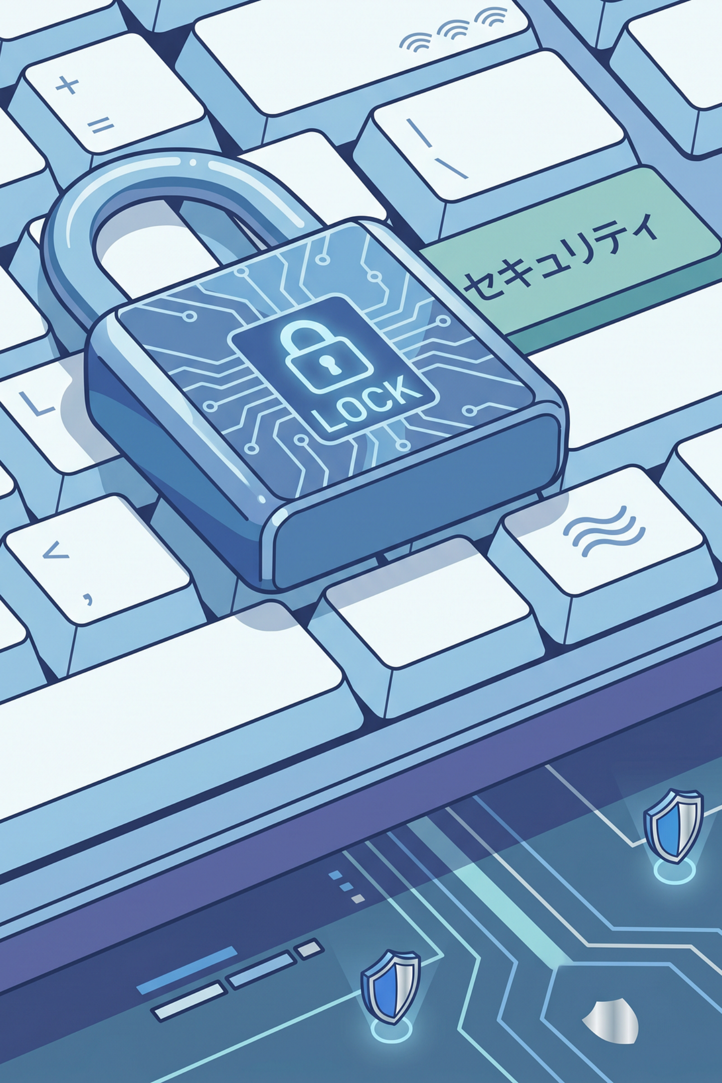
PASSWORDS
Four password habits that matter.
Use a password manager
Bitwarden is free, open-source, and works across all devices. It removes the need to remember passwords — or write them down.
Never reuse a password across systems
One compromised account should not hand over all your others. A password manager makes this easy to maintain.
Turn on 2FA for email and Tally
Two-factor authentication means a stolen password alone is not enough to break in. Enable it now if you have not already.
If you wrote a password on a sticky note, change it today
The sticky note on your monitor, under your keyboard, or in your desk drawer is not secure. Change the password and move it into your password manager.

Slide 10


SPOTTING PHISHING
Three signs. One action. One thing never to do.
Three signs of a phishing email
What to do
1
2
Forward to your manager.One forward. No action needed beyond that. Your manager or the IT-of-one will investigate and advise.
Urgency
Mismatched sender
"Your account will be suspended in 24 hours." "Respond immediately." Pressure to act fast is designed to stop you from thinking carefully.
The display name says "Tally Support" but the actual email address is something unrelated. Always check the full address, not just the name.
What never to do
Do not click anything in the email.Not the unsubscribe link. Not the attachment. Not the "view in browser" link. Nothing.
3
Links you do not recognise
Hover over any link before clicking. If the URL looks unfamiliar, abbreviated, or misspelled — do not click it.

Slide 11

AI TOOLS
The company AI policy — three lines.
AI tools are useful. They are also, at present, data collection systems for the companies that run them. What you type into them can be used to train future models. The policy is straightforward.
Rule 1 — Company data stays out
Rule 2 — Ask before you adopt
Rule 3 — Slip-ups must be reported
Before using a new AI tool for work tasks, check with the IT-of-one. Some tools have enterprise versions with appropriate data handling. Some do not. The check takes five minutes.
Customer data, engineering designs, financial figures, and any internal business information do not go into ChatGPT, Claude, Gemini, Copilot, or any other AI tool — regardless of whether it appears to be private or confidential mode.
If you entered company data into an AI tool — even accidentally — tell your manager within 24 hours. The same no-penalty rule applies. Hiding it does not.
The "it's just a draft" exception does not exist. Even pasting a draft email with a client's name, project reference, or financial figure into an AI tool counts as sending company data outside company systems.

Slide 12
QUESTIONS
Questions are always welcome.
If something in this deck is unclear, if you are unsure whether a specific action is allowed, or if you spotted something that needs to be reported — there are three ways to reach the right person.
Your manager
The IT-of-one
hello@siriusstar.in
First point of contact for any data safety question, incident, or observation. Same-day response expected.
For technical questions — password managers, 2FA setup, approved tools, device policy — speak to the IT administrator directly.
For questions that go beyond your manager or internal IT — or if you need an outside perspective on a data safety concern.

Slide 13
Sirius Star Enterprise Technologies
IT that keeps your plant running — and your engineering IP locked down.
sudeep@siriusstar.in | +91-96996-05668 | siriusstar.in

